Slide 1
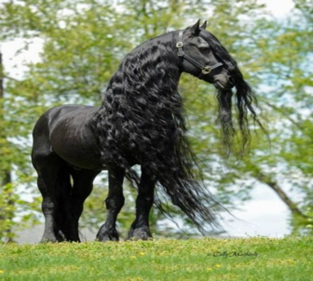
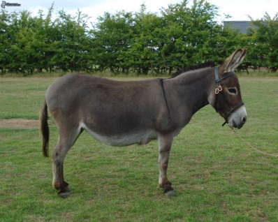
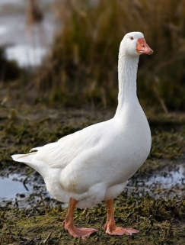
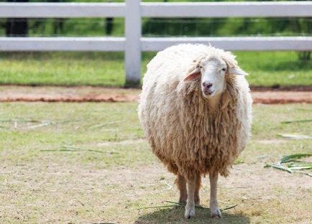
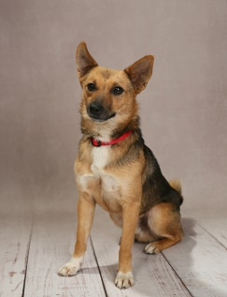
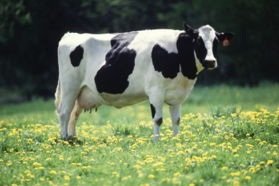
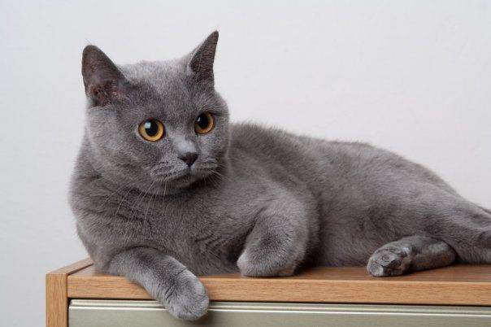
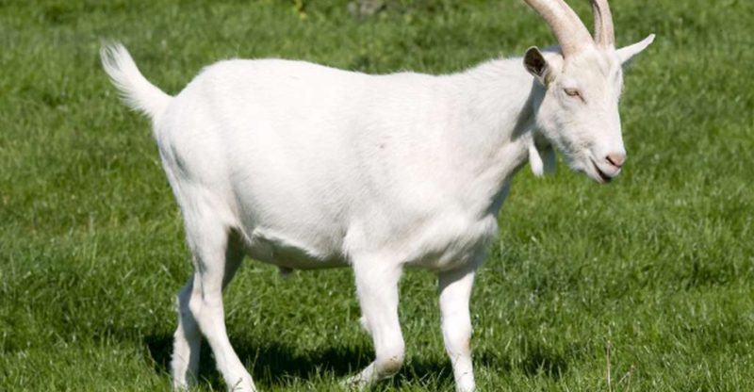
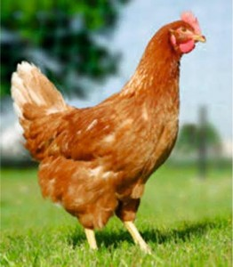
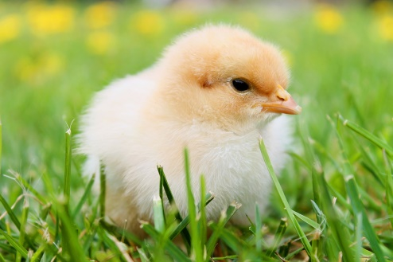
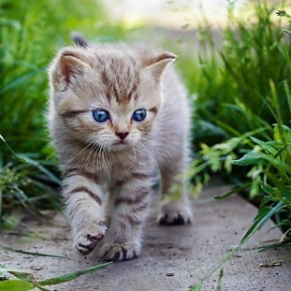
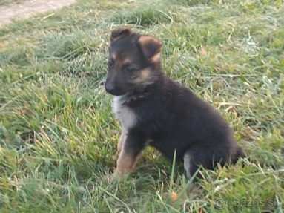
FARM ANIMALS
horse
goose
donkey
sheep
dog
cow
goat
cat
hen
kitty
puppy
chicken

Slide 2
The sentences about farm animal
The goat is smaller than the cow.
The cow is bigger than the chicken.
The goose is smaller than donkey.
The kitty is smaller than the dog.
The puppy is smaller then the cat.
The horse is taller then the sheep.
The donkey is bigger then the hen.
The cow is bigger then the cat.
The goose is bigger then the kitty.
The goat is bigger then the puppy.

