Slide 1
FARM ANIMALS
Milan Kučavík

Slide 2
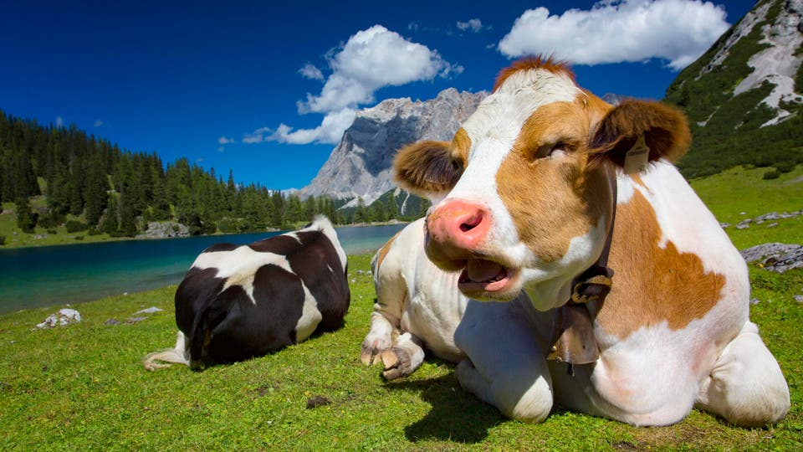
COW

Slide 3
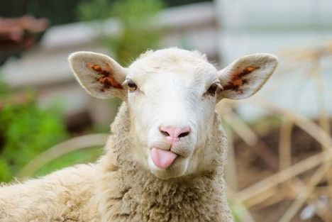
SHEEP

Slide 4
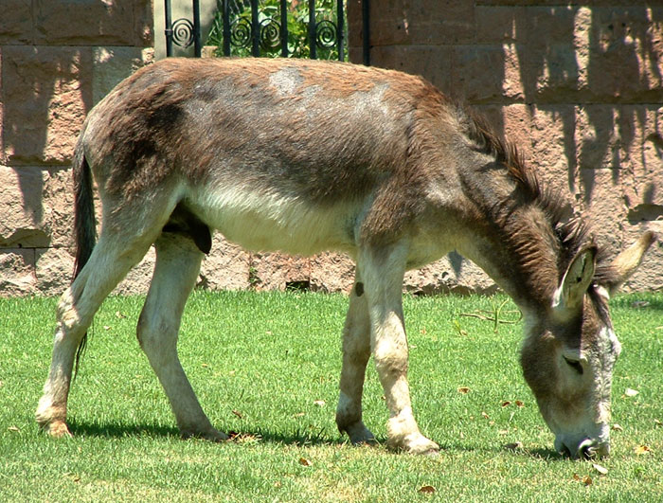
DONKEY

Slide 5
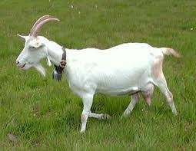
GOAT

Slide 6
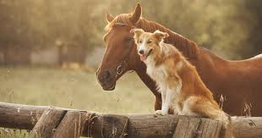
HORSE AND DOG

Slide 7
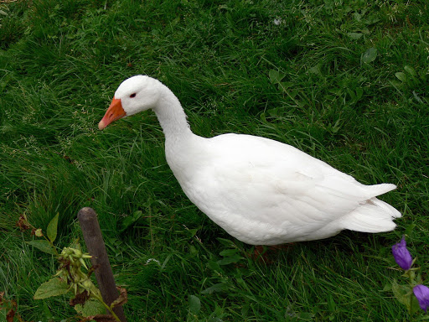
GOOSE

